Slide 1



Digit Classifier Using CNN
This presentation explores digit classification. We'll use Convolutional Neural Networks (CNNs). The MNIST dataset is crucial.
by Mohammed Sardar Saajit

Slide 2

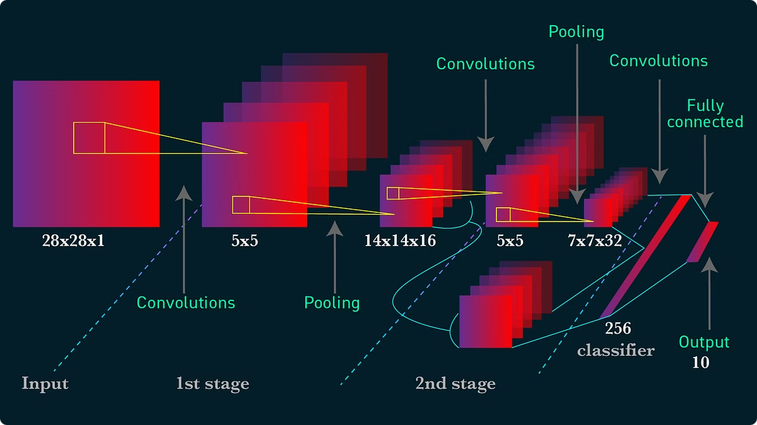
Overview of Convolutional Neural Networks (CNNs)
1
Convolutional Layers
2
Pooling Layers
Extract features from images using filters.
Reduce dimensionality and computational cost.
3
Fully Connected Layers
Perform classification based on extracted features.

Slide 3

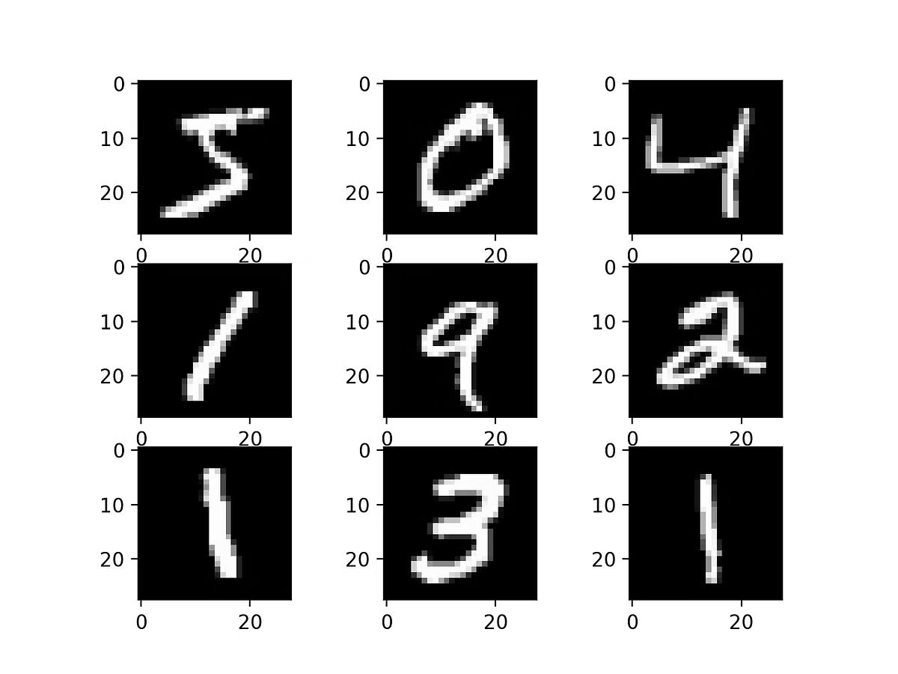
Understanding the MNIST Dataset
Composition
Format
60,000 training images and 10,000 testing images.
28x28 grayscale images of handwritten digits 0-9.
Significance
Widely used benchmark for machine learning algorithms.

Slide 4





CNN Architecture and Layers
Input Layer
Accepts 28x28 grayscale images.
Convolutional Layers
Feature extraction using filters.
Pooling Layers
Dimensionality reduction.
Fully Connected Layers
Classification into digits 0-9.
Output Layer
Provides probability for each digit.

Slide 5
Feature Extraction and Representation
Convolutional Filters
Feature Maps
Hierarchical Features
Detect edges, corners, and other features.
Represent the presence of features at different locations.
Higher layers detect more complex features from lower-level ones.

Slide 6

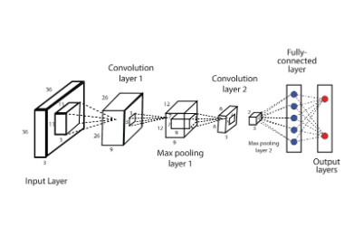
Training a CNN Model for Digit Classification
1
Data Preprocessing
Normalize pixel values and split into training/testing sets.
2
Model Training
Use backpropagation and optimization algorithms like Adam or SGD.
3
Loss Function
Categorical cross-entropy to measure model accuracy.

Slide 7

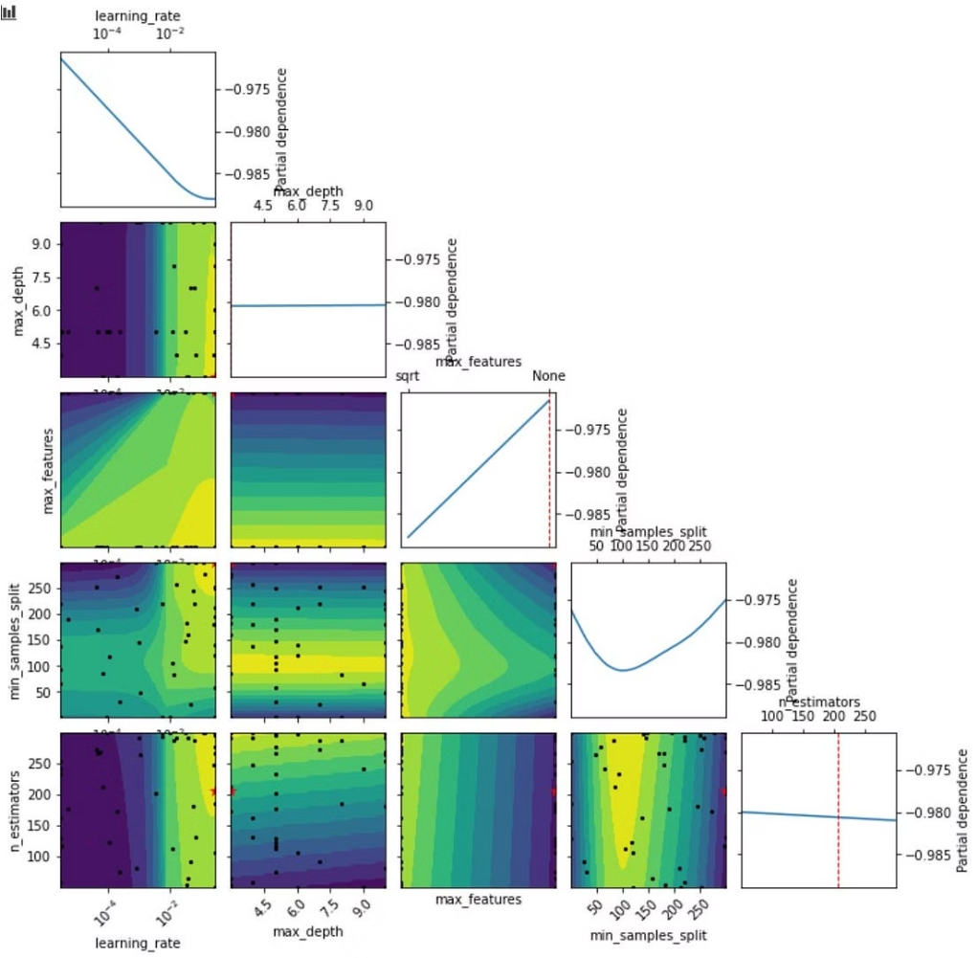
Hyperparameter Tuning and Optimization
Hyperparameter
Description
Typical Values
Learning Rate
Controls the step size during optimization.
0.001, 0.01, 0.1
Number of Layers
Affects model capacity.
2-5
Filter Size
Determines the receptive field of convolutional layers.
3x3, 5x5

Slide 8



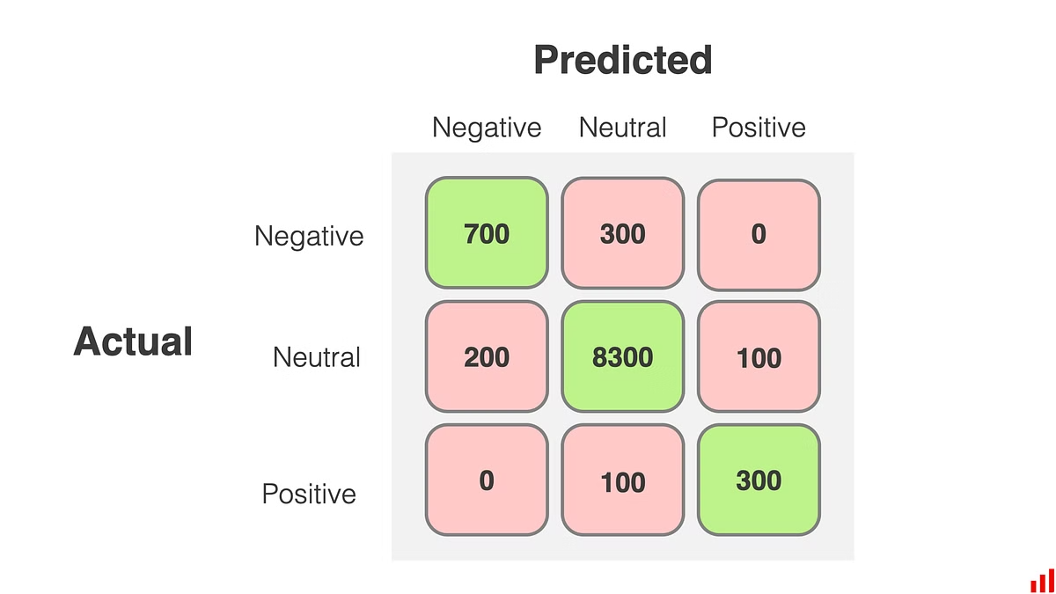


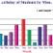

Model Evaluation and Performance Metrics
Accuracy
Precision
Percentage of correctly classified digits.
Proportion of true positives among predicted positives.
Recall
F1-Score
Proportion of true positives among actual positives.
Harmonic mean of precision and recall.
Results
Accuracy
Accuracy: The CNN model achieved an accuracy of 98% on the MNIST test dataset.
Logistic Regression: 91.8% accuracySVM: 97% accuracyRandom Forest: 95.9% accuracyk-NN: 95.9% accuracy
Performance Comparison: CNN outperformed traditional machine learning models,such as:

Slide 9


Real-world Applications of Digit Classification
1
Postal Automation
2
Bank Check Processing
Automatic sorting of mail based on zip codes.
Recognition of account numbers and amounts.
3
License Plate Recognition
Automated identification of vehicles.

Slide 10


Conclusion and Future Directions
CNNs are effective for digit classification whicj achived . Further research focuses on improving accuracy and efficiency. Exploring more complex datasets is important.

Slide 11
Thank You

